Slide 2

X
01
Moving Around
Voting
How easy is it to move around and get to where I want to go?
1
2
3
4
5
6
7
Things to Think About...
Are paths and routes suitable?
Are there enough routes for people to get to where they want to go?
Are routes attractive and safe?
Can everyone use them?
Are there any barriers?
General Feedback
Type your feedback here
Type your feedback here
Type your feedback here
Type your feedback here
Type your feedback here
Type your feedback here
Type your feedback here
Type your feedback here
Notes:
Pleasant and safe routes can encourage people to move around by walking, wheeling and cycling without relying on cars or public transport – this is good for health and for the environment and air quality. This can include off-road paths, wide pavements, quiet streets with reduced speed limits, and walking and cycling routes that can be used by people with wheelchairs, mobility aids, prams or adapted bikes.
Things to Think About...
Are paths and routes suitable? (walk, wheel, or cycle, adapted bikes)
Are there enough routes for people to get to where they want to go?(shops, school, work, parks, public transport)
Are routes attractive and safe? (good surfaces, well-lit, seating, continuous, clean and clear, free from pollution, all weathers)
Can everyone use them? (all ages and mobility, vision/ hearing impaired, pushchairs and prams, mobility aids, bikes)
Are there any barriers? (pavement parking, traffic volume/ speed, overgrown hedges, refuse bins; lack of dropped kerbs or tactile paving, no safe crossing points, no safe mobility aid/bike parking or storage)

Slide 3
General Feedback
01
Moving Around
Type your feedback here
Type your feedback here
Type your feedback here
Type your feedback here
What could encourage people to move around in ways that avoid using petrol and diesel? Consider walking, wheeling, cycling, electric vehicles?
How could people reduce the amount of travel done using petrol or diesel?
Type your feedback here
Type your feedback here
Type your feedback here
Type your feedback here
Type your feedback here
Type your feedback here
Type your feedback here
Type your feedback here
Is moving around in different weather conditions - for example, rain, snow, wind, and heat - possible for everyone?
What alternative options are there? What would help to make active journeys more comfortable in all weathers?
Type your feedback here
Type your feedback here
Type your feedback here
Type your feedback here
Notes:
What could encourage people to move around in ways that avoid using petrol and diesel? Consider walking, wheeling, cycling, electric vehicles?
How could people reduce the amount of travel done using petrol or diesel?
Is moving around in different weather conditions - for example, rain, snow, wind, and heat - possible for everyone?
What alternative options are there? What would help to make active journeys more comfortable in all weathers?

Slide 4

X
02
Public Transport
Voting
What is public transport like in my place?
1
2
3
4
5
6
7
Things to Think About...
Is public transport a good option?
Can everyone use services?
Do facilities and services have what people need?
Is there information on services?
Does the public transport system allow people to get to where they need to go if they can’t get there by walking, wheeling or cycling?
General Feedback
Type your feedback here
Type your feedback here
Type your feedback here
Type your feedback here
Type your feedback here
Type your feedback here
Type your feedback here
Type your feedback here
Notes:
Good public transport is accessible, affordable, reliable and well connected. This can reduce reliance on cars and encourage people to get around in ways that are better for the environment and for their health.
Things to Think About...
Is public transport a good option? (safe and convenient, frequent and reliable, affordable, clean and comfortable, easy to change between services)
Can everyone use services? (wheelchairs, prams, vision/ hearing impaired, cyclists, all weathers, all times)
Do facilities and services have what people need? (toilets, seating, shelter from weather, visual/ audio help points, green/ low emissions, cycle storage, car parking)
Is there information on services? (easy to find, easy to use, clear and accessible)
Does the public transport system allow people to get to where they need to go if they can’t get there by walking, wheeling or cycling? (health centre, shops, work, to meet friends, parks)

Slide 5
General Feedback
02
Public Transport
Type your feedback here
Type your feedback here
Type your feedback here
Type your feedback here
What would support people to use public transport more? How could we reduce or replace car use?
Type your feedback here
Type your feedback here
Type your feedback here
Type your feedback here
Type your feedback here
Type your feedback here
Type your feedback here
Type your feedback here
Are there delays or cancellations due to the weather?
What do people do?
How could we make it more comfortable to use public transport - waiting for it and travelling on it - in any weather?
Type your feedback here
Type your feedback here
Type your feedback here
Type your feedback here
Notes:
What would support people to use public transport more? How could we reduce or replace car use?
Are there delays or cancellations due to the weather?
What do people do?
How could we make it more comfortable to use public transport - waiting for it and travelling on it - in any weather?

Slide 6

X
03
Traffic & Parking
Voting
How do traffic and parking affect how I move around my place?
1
2
3
4
5
6
7
Things to Think About...
Do people have priority over vehicles?
How does traffic affect people?
What impact does parking have?
What is parking like?
Are there options for lower carbon travel?
General Feedback
Type your feedback here
Type your feedback here
Type your feedback here
Type your feedback here
Type your feedback here
Type your feedback here
Type your feedback here
Type your feedback here
Notes:
Traffic and parking affects how people move around. Good arrangements can help people to get the most out of their place.
Things to Think About...
Do people have priority over vehicles? (traffic calming measures, good pedestrian routes, safe road crossing points)
How does traffic affect people? (congestion, speed, pollution, noise, fear of vehicles or bicycles, delivery vehicles)
What impact does parking have? (on walking, wheeling and cycling, accessibility of pavements, attractiveness of the area)
What is parking like? (safe and secure, in a convenient location, accessible for blue badge holders, cars/ bicycles, inconsiderate parking)
Are there options for lower carbon travel? (bike hire or sharing schemes, ebikes, park and ride, car clubs, car sharing schemes, electric vehicle charging)

Slide 7
General Feedback
03
Traffic & Parking
Type your feedback here
Type your feedback here
Type your feedback here
Type your feedback here
How can we change our place so that cars are not the most convenient choice, especially for short journeys? This may involve traffic free spaces, dedicated active travel routes, e-bikes, changing where cars park.
Is there safe parking available for alternatives such as mobility aids, buggies, cycles, electric cycles, including bigger cargo bikes and trike?
What about parking and charging for electric cars?
How could walking and cycling become the more convenient and appealing option?
Type your feedback here
Type your feedback here
Type your feedback here
Type your feedback here
Type your feedback here
Type your feedback here
Type your feedback here
Type your feedback here
Are there locations that a lot of people go to in good weather?
Are there covered and secure cycling parking areas?
Type your feedback here
Type your feedback here
Type your feedback here
Type your feedback here
Notes:
How can we change our place so that cars are not the most convenient choice, especially for short journeys? This may involve traffic free spaces, dedicated active travel routes, e-bikes, changing where cars park.
Is there safe parking available for alternatives such as mobility aids, buggies, cycles, electric cycles, including bigger cargo bikes and trike?
What about parking and charging for electric cars?
How could walking and cycling become the more convenient and appealing option?
Are there locations that a lot of people go to in good weather?
Are there covered and secure cycling parking areas?

Slide 8

X
04
Streets & Spaces
Voting
What are the buildings, streets and public spaces like in my place?
1
2
3
4
5
6
7
Things to Think About...
What are streets and spaces like?
Are there points of interest?
Is it easy to find my way around?
How accessible are spaces for everyone?
Are there any challenges?
General Feedback
Type your feedback here
Type your feedback here
Type your feedback here
Type your feedback here
Type your feedback here
Type your feedback here
Type your feedback here
Type your feedback here
Notes:
Buildings, landmarks, greenery, views and natural landscape can help to create an attractive place that people enjoy being in. Distinctive streets and spaces can help people to find their way around, and greener streets and spaces are not just good for wellbeing but also for the environment and for biodiversity.
Things to Think About...
Here are some things to think about:
What are streets and spaces like? (welcoming, distinctive, pleasant, accessible, fun, sheltered, shaded, green, places to rest, adaptable)
Are there points of interest? (local landmarks, historic features, public squares, parks and gardens, trees)
Is it easy to find my way around? (good surfaces, visual features, well signposted, direct and easy routes to follow)
How accessible are spaces for everyone? (pavement width, crossing points, tactile surfaces, dropped kerbs)
Are there any challenges? (flooding, derelict buildings, vacant land, pollution, litter, lighting, busy roads, pavement clutter, illegal parking)

Slide 9
General Feedback
04
Streets & Spaces
Type your feedback here
Type your feedback here
Type your feedback here
Type your feedback here
Where could streets and spaces have trees and more green spaces? This can help to improve air quality, store carbon, and grow food?
How can we enhance streets to make them an appealing place to spend time and carry out daily activities on foot?
How can we make streets safe and inclusive for everyone? Including those with physical and sensory disabilities?
Type your feedback here
Type your feedback here
Type your feedback here
Type your feedback here
How can we make sure streets and spaces are still safe and pleasant places to walk, meet or socialise even in bad weather?
Or do they go elsewhere?
Are high temperatures an issue in areas where there is no shade?
Could streets and urban spaces be rearranged to make room for trees and greenspace? These can provide benefits in reducing temperature extremes and surface water flooding.
Type your feedback here
Type your feedback here
Type your feedback here
Type your feedback here
Type your feedback here
Type your feedback here
Type your feedback here
Type your feedback here
Notes:
Where could streets and spaces have trees and more green spaces? This can help to improve air quality, store carbon, and grow food?
How can we enhance streets to make them an appealing place to spend time and carry out daily activities on foot?
How can we make streets safe and inclusive for everyone? Including those with physical and sensory disabilities?
How can we make sure streets and spaces are still safe and pleasant places to walk, meet or socialise even in bad weather?
Or do they go elsewhere?
Are high temperatures an issue in areas where there is no shade?
Could streets and urban spaces be rearranged to make room for trees and greenspace? These can provide benefits in reducing temperature extremes and surface water flooding.

Slide 10

X
05
Natural Space
Voting
How easy is it for me to regularly enjoy natural space?
1
2
3
4
5
6
7
Things to Think About...
What kind of natural spaces are there?
Can everyone use the spaces?
Are spaces looked after?
What stops people using spaces?
How can natural spaces work better for us?
General Feedback
Type your feedback here
Type your feedback here
Type your feedback here
Type your feedback here
Type your feedback here
Type your feedback here
Type your feedback here
Type your feedback here
Notes:
Good quality natural spaces provide many benefits – improving health and wellbeing, supporting wildlife, reducing flooding, and improving air quality.
This includes parks and woodlands, fields, streams, canals and rivers, the coastline, green spaces alongside paths and roads, and tree-lined streets.
Things to Think About...
What kind of natural spaces are there? (welcoming, easy to get to, accessible, safe and secure, well-connected, meets my needs)
Can everyone use the spaces? (disabled people, dog walking, prams and buggies, walking and cycling, local food growing, playing, places to rest)
Are spaces looked after? (clean, safe, in good order, community volunteers)
What stops people using spaces? (litter, noise, dog fouling, surface mud/ dirt, air quality, flooding, no seating, overcrowding, no toilets)
How can natural spaces work better for us? (drainage, rewilding, protect and encourage wildlife and nature, tree planting, cleaner air, shade)

Slide 11
General Feedback
05
Natural Space
Type your feedback here
Type your feedback here
Type your feedback here
Type your feedback here
Can existing natural spaces be made better at absorbing carbon from the atmosphere? For example, through tree planting, peatland restoration, or wetland creation?
Are existing natural spaces accessible and engaging?
How can green spaces - such as parks, gardens - better enhance biodiversity?
Type your feedback here
Type your feedback here
Type your feedback here
Type your feedback here
Type your feedback here
Type your feedback here
Type your feedback here
Type your feedback here
Could more natural space be available in your place? Even small spaces can develop to encourage wildlife.
Is there space available to soak up rainwater and provide space for flood water? Also to provide shade, and shelter?
Type your feedback here
Type your feedback here
Type your feedback here
Type your feedback here
Notes:
Can existing natural spaces be made better at absorbing carbon from the atmosphere? For example, through tree planting, peatland restoration, or wetland creation?
Are existing natural spaces accessible and engaging?
How can green spaces - such as parks, gardens - better enhance biodiversity?
Could more natural space be available in your place? Even small spaces can develop to encourage wildlife.
Is there space available to soak up rainwater and provide space for flood water? Also to provide shade, and shelter?

Slide 12

X
06
Play & Recreation
Voting
How good are the spaces and opportunities for play and recreation in my place?
1
2
3
4
5
6
7
Things to Think About...
What opportunities are there?
Are there places that everyone can enjoy?
Are spaces and facilities well used?
How else could we make the most of what we have?
Are there any issues?
General Feedback
Type your feedback here
Type your feedback here
Type your feedback here
Type your feedback here
Type your feedback here
Type your feedback here
Type your feedback here
Type your feedback here
Notes:
Play and recreation can improve the quality of our lives and our health and wellbeing. Good opportunities for play are essential for children’s development. Places with a range of formal and informal indoor and outdoor spaces and events encourage children, teenagers and adults to play and to enjoy leisure, culture and sporting activities.
Things to Think About...
What opportunities are there? (play, sports, culture, arts, leisure)
Are there places that everyone can enjoy? (children and young people, adults and older people, non-disabled and disabled, vision/ hearing impaired, locals and visitors)
Are spaces and facilities well used? (easy to get to, free or affordable, safe and well maintained, fun and welcoming, different times of day or year)
How else could we make the most of what we have? (streets close to home, vacant and derelict land, playgrounds, natural spaces, libraries and public buildings, hosting activities and events)
Are there any issues? (access, location, lighting, noise, cost, public toilets, traffic, weather, play not welcomed by the community)

Slide 13
General Feedback
06
Play & Recreation
Type your feedback here
Type your feedback here
Type your feedback here
Type your feedback here
How can we increase local play and recreation opportunities? What is available to avoid people feeling they need to drive for their leisure time?
Type your feedback here
Type your feedback here
Type your feedback here
Type your feedback here
Think about how and where people play and spend their time in different weather conditions.
Could playspaces or parkland become multipurpose allowing for flooding to protect buildings and infrastructure downstream?
Does the weather ever lead to overcrowding of spaces or facilities? For example, outdoor spaces in hot weather, indoor facilities in rain or cold?
Type your feedback here
Type your feedback here
Type your feedback here
Type your feedback here
Type your feedback here
Type your feedback here
Type your feedback here
Type your feedback here
Notes:
How can we increase local play and recreation opportunities? What is available to avoid people feeling they need to drive for their leisure time?
Think about how and where people play and spend their time in different weather conditions.
Could playspaces or parkland become multipurpose allowing for flooding to protect buildings and infrastructure downstream?
Does the weather ever lead to overcrowding of spaces or facilities? For example, outdoor spaces in hot weather, indoor facilities in rain or cold?

Slide 14

X
07
Facilities & Services
Voting
How well do facilities and services in my place meet my needs?
1
2
3
4
5
6
7
Things to Think About...
What facilities and services are there?
What other support is available?
Do the facilities and services meet local needs, now and in the future?
Are facilities and services easy to get to and use?
Are there other barriers for people?
General Feedback
Type your feedback here
Type your feedback here
Type your feedback here
Type your feedback here
Type your feedback here
Type your feedback here
Type your feedback here
Type your feedback here
Notes:
When the facilities and services in a place, such as schools, doctors, shops, libraries, social care and community groups are easy to access locally, this can help people to live independent, healthy and fulfilling lives. It can be difficult for some people where there is a lack of local facilities, the quality of those facilities is poor, or where the services and support available in the community is limited.
Things to Think About...
What facilities and services are there? (schools and education, health facilities, social care, shops, library and culture, community centres and halls, recycling and repair, healthy food, leisure, gas, electricity and water)
What other support is available? (charities and clubs, welfare support, community food groups, places of worship, housing and employment advice)
Do the facilities and services meet local needs, now and in the future? (affordable, all ages, different needs and abilities, responsive to emergencies)
Are facilities and services easy to get to and use? (within a reasonable walking, wheeling or cycling distance, for disabled people, available online, linked to other services)
Are there other barriers for people? (unwelcoming, limited healthy choices, language, internet access)

Slide 15
General Feedback
07
Facilities & Services
Type your feedback here
Type your feedback here
Type your feedback here
Type your feedback here
Food security is becoming more challenging. Is food grown in the area and how could this be better supported?
What else do local people need to reduce the impact of their consumption? Is there recycling, repair or sharing resources nearby?
What space is there for removing greenhouse gases from the atmosphere? Either trees or through technical carbon capture?
Can I access what I need locally? Are there spaces where I can access services online to reduce the need to travel? For example, digital medical consultations?
Type your feedback here
Type your feedback here
Type your feedback here
Type your feedback here
Type your feedback here
Type your feedback here
Type your feedback here
Type your feedback here
How do facilities and services cope with extreme weather?
Is demand affected by different weather?
Are there plans in place to help people access services in hazardous conditions?
Type your feedback here
Type your feedback here
Type your feedback here
Type your feedback here
Notes:
Food security is becoming more challenging. Is food grown in the area and how could this be better supported?
What else do local people need to reduce the impact of their consumption? Is there recycling, repair or sharing resources nearby?
What space is there for removing greenhouse gases from the atmosphere? Either trees or through technical carbon capture?
Can I access what I need locally? Are there spaces where I can access services online to reduce the need to travel? For example, digital medical consultations?
How do facilities and services cope with extreme weather?
Is demand affected by different weather?
Are there plans in place to help people access services in hazardous conditions?

Slide 16

X
08
Work & Local Economy
Voting
How active is the local economy in my place and are there good opportunities for work, volunteering and training?
1
2
3
4
5
6
7
Things to Think About...
Is there an active local economy?
Is there work available in the local area for those that want it?
Are there opportunities for people to build skills?
What support is available?
Are there any challenges?
How does the local economy affect how I feel about my place?
General Feedback
Type your feedback here
Type your feedback here
Type your feedback here
Type your feedback here
Type your feedback here
Type your feedback here
Type your feedback here
Type your feedback here
Notes:
A strong local economy with a mix of businesses can help to make places feel active and attractive – most people enjoy spending time in lively places. Access to good quality jobs, volunteering and training within a reasonable distance can help us to stay active and healthy, provide social connections, a sense of identity and satisfaction, and an income where paid.
Things to Think About...
Is there an active local economy? (able to spend locally (shop/ eat/ drink), mix of businesses, including local and community-owned, opening days/ times)
Is there work available in the local area for those that want it? (a mix of jobs, paid work and volunteering, temporary and permanent, seasonal and parttime positions)
Are there opportunities for people to build skills? (education, training or retraining, community work, local or accessible nearby)
What support is available? (for people with different needs, employment advice, starting and growing a business, childcare, travel)
Are there any challenges? (pollution, noise, reliance on a few major employers, broadband, working conditions, closed businesses)
How does the local economy affect how I feel about my place? (thriving or declining, lots of activity or empty streets, boarded up or attractive buildings)

Slide 17
General Feedback
08
Work & Local Economy
Type your feedback here
Type your feedback here
Type your feedback here
Type your feedback here
Are there opportunities for work and training that is part of the move to a net zero economy? For example, jobs in green technologies providing low carbon products and services?
Think about new jobs that could be available in the area, especially if there has been a loss of traditional industry. For example, renewable energy, forestry, retrofitting homes with energy efficiency measures, repair and reuse, maintenance of low carbon technologies, habitat restoration?
How can we make sure everyone has a role when it comes to the transition to a low carbon economy? Are there local industries that will suffer or people who may need to retrain?
Type your feedback here
Type your feedback here
Type your feedback here
Type your feedback here
Type your feedback here
Type your feedback here
Type your feedback here
Type your feedback here
Have any businesses struggled following severe weather? What could help them to cope or get up and running again?
Are people able to work from home/ a local work hub if bad weather disrupts travel to a more distant workplace?
Type your feedback here
Type your feedback here
Type your feedback here
Type your feedback here
Notes:
Are there opportunities for work and training that is part of the move to a net zero economy? For example, jobs in green technologies providing low carbon products and services?
Think about new jobs that could be available in the area, especially if there has been a loss of traditional industry. For example, renewable energy, forestry, retrofitting homes with energy efficiency measures, repair and reuse, maintenance of low carbon technologies, habitat restoration?
How can we make sure everyone has a role when it comes to the transition to a low carbon economy? Are there local industries that will suffer or people who may need to retrain?
Have any businesses struggled following severe weather? What could help them to cope or get up and running again?
Are people able to work from home/ a local work hub if bad weather disrupts travel to a more distant workplace?

Slide 18

X
09
Housing & Community
Voting
How well do the homes in my place meet the needs of my community?
1
2
3
4
5
6
7
Things to Think About...
Is there a good mix of housing types?
Are residential areas attractive?
Are homes and places able to adapt to changing circumstances?
Is there a good community spirit?
Are there any challenges?
General Feedback
Type your feedback here
Type your feedback here
Type your feedback here
Type your feedback here
Type your feedback here
Type your feedback here
Type your feedback here
Type your feedback here
Notes:
Good places have a mix of housing in attractive, safe and connected communities for different types of families and people. Where we live and call home affects our health and wellbeing.
Things to Think About...
• Is there a good mix of housing types? (different sizes, various prices, privately owned, rented, specialist housing, supported living, multi-generational)
• Are residential areas attractive? (well maintained homes, private and community gardens, well laid out, communal areas)
• Are homes and places able to adapt to changing circumstances? (changing climate, population changes, global health challenges, energy efficiency)
• Is there a good community spirit? (local activities and events, friendly neighbours, welcoming neighbourhoods, intergenerational mixing)
• Are there any challenges? (damp/ draughty homes, secure boundaries, flooding, noise and disturbance, homelessness, anti-social behaviour, no storage)

Slide 19
General Feedback
09
Housing & Community
Type your feedback here
Type your feedback here
Type your feedback here
Type your feedback here
Are homes energy efficient, easy/ affordable to heat?
Are there local renewable energy or low carbon energy resources to heat or power homes? For example, wind, wave, rivers, forestry, solar, district heat networks.
Do homes have space for cycle storage, charging electric vehicles and for recycling facilities?
Type your feedback here
Type your feedback here
Type your feedback here
Type your feedback here
Type your feedback here
Type your feedback here
Type your feedback here
Type your feedback here
Are homes healthy places to live? Are they prone to flooding, damp/ mould, draughts, cold, or over-heating?
Type your feedback here
Type your feedback here
Type your feedback here
Type your feedback here
Notes:
Are homes energy efficient, easy/ affordable to heat?
Are there local renewable energy or low carbon energy resources to heat or power homes? For example, wind, wave, rivers, forestry, solar, district heat networks.
Do homes have space for cycle storage, charging electric vehicles and for recycling facilities?
Are homes healthy places to live? Are they prone to flooding, damp/ mould, draughts, cold, or over-heating?

Slide 20
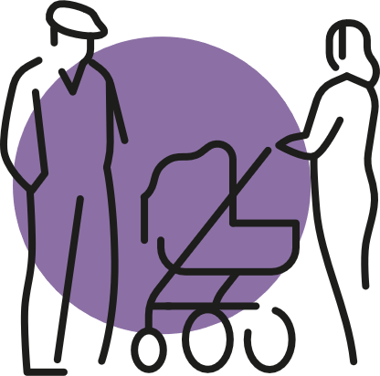
X
10
Social Interaction
Voting
How good is the range of opportunities which allow me to meet and spend time with other people?
1
2
3
4
5
6
7
Things to Think About...
Where do people get together?
How do people find out what’s happening?
Can everyone join in and mix?
Is there a mix of activities?
Would people come together in a crisis?
Are there any gaps?
General Feedback
Type your feedback here
Type your feedback here
Type your feedback here
Type your feedback here
Type your feedback here
Type your feedback here
Type your feedback here
Type your feedback here
Notes:
Good places have a mix of spaces and opportunities to meet and spend time with other people. Some places also have active websites or social media networks to help people meet and take part in the local community. Feeling isolated can be damaging to our health and wellbeing.
Things to Think About...
• Where do people get together? (local halls and centres, schools, places of worship, food and drink outlets, streets, outdoor seating, online)
• How do people find out what’s happening? (friends/ family/ neighbours, social media, advertising and posters, local radio and newspapers)
• Can everyone join in and mix? (accessible, friendly, inclusive, welcoming, free or affordable, digital access and skills)
• Is there a mix of activities? (indoor and outdoor groups, kids clubs and pensioner clubs, community activities, events, specialist groups)
• Would people come together in a crisis? (networks, support groups, resources)
• Are there any gaps? (type of activities, type of spaces, use of spaces)

Slide 21
General Feedback
10
Social Interaction
Type your feedback here
Type your feedback here
Type your feedback here
Type your feedback here
Are there opportunities for people to support each other to reduce their emissions? For example, informal sharing of bikes, cars, excess food, and other items to reduce waste?
Type your feedback here
Type your feedback here
Type your feedback here
Type your feedback here
Type your feedback here
Type your feedback here
Type your feedback here
Type your feedback here
In an emergency - such as flooding, heatwave - is everybody looked after? Think about vulnerable groups and their support needs (some effects can be long-lasting).
Type your feedback here
Type your feedback here
Type your feedback here
Type your feedback here
Notes:
Are there opportunities for people to support each other to reduce their emissions? For example, informal sharing of bikes, cars, excess food, and other items to reduce waste?
In an emergency - such as flooding, heatwave - is everybody looked after? Think about vulnerable groups and their support needs (some effects can be long-lasting).

Slide 22

X
11
Identity & Belonging
Voting
To what extent does my place have a positive identity that supports a strong sense of belonging?
1
2
3
4
5
6
7
Things to Think About...
How strong is the sense of identity and belonging?
How does the community celebrate?
How involved are people in the community?
How welcoming are people in this place?
What do others think of the place and community?
General Feedback
Type your feedback here
Type your feedback here
Type your feedback here
Type your feedback here
Type your feedback here
Type your feedback here
Type your feedback here
Type your feedback here
Notes:
How a place looks, its history and what other people think of it can affect how we feel. A positive identity can also attract people and businesses to move into an area.
Things to Think About...
How strong is the sense of identity and belonging? (pride, neighbourliness, traditions, local groups)
How does the community celebrate? (history/ heritage/ arts/ music/ culture, sports, public events, social media, our uniqueness, our inclusiveness)
How involved are people in the community? (volunteering, sharing experiences, support networks, different groups, come together in a crisis)
How welcoming are people in this place? (friendliness, tolerance and openness, all ages and ethnicities, for disabled people, language, culture)
What do others think of the place and community? (reputation, profile, community)

Slide 23
General Feedback
11
Identity & Belonging
Type your feedback here
Type your feedback here
Type your feedback here
Type your feedback here
Does everyone feel that they can contribute to action taken to address climate change at a local level?
Type your feedback here
Type your feedback here
Type your feedback here
Type your feedback here
Type your feedback here
Type your feedback here
Type your feedback here
Type your feedback here
Is there a shared sense within the community that climate change is an issue that will affect everyone?
Type your feedback here
Type your feedback here
Type your feedback here
Type your feedback here
Notes:
Does everyone feel that they can contribute to action taken to address climate change at a local level?
Is there a shared sense within the community that climate change is an issue that will affect everyone?

Slide 24

X
12
Feeling Safe
Voting
How safe does my place make me feel?
1
2
3
4
5
6
7
Things to Think About...
Does everyone feel safe in our place?
Are there physical barriers or areas that feel unsafe?
Are there social issues?
How do we share our concerns?
Are there other issues?
General Feedback
Type your feedback here
Type your feedback here
Type your feedback here
Type your feedback here
Type your feedback here
Type your feedback here
Type your feedback here
Type your feedback here
Notes:
How safe a place feels can support community activity, affect people’s wellbeing and influence how and where we spend our time. Good design and maintenance can make places feel safe by reducing crime and antisocial behaviour.
Things to Think About...
Does everyone feel safe in our place? (daytime, evening and night-time, children and teenagers, adults and older people, women)
Are there physical barriers or areas that feel unsafe? (lighting, derelict buildings, empty homes, vacant land, overgrown areas, clean/ clear paths, flooding)
Are there social issues? (freedom of speech, anti-social behaviour, hate crime, inequality, lack of diversity)
How do we share our concerns? (neighbourhood watch, reporting crime, social media)
Are there other issues? (litter and graffiti, hidden or unreported crimes, unsafe at specific times/ certain places, traffic speed and volume)

Slide 25
General Feedback
12
Feeling Safe
Type your feedback here
Type your feedback here
Type your feedback here
Type your feedback here
How can we help people feel safer, so they don’t feel they need private cars to protect them?
Type your feedback here
Type your feedback here
Type your feedback here
Type your feedback here
Type your feedback here
Type your feedback here
Type your feedback here
Type your feedback here
Are there environmental or weather conditions which make this place feel unsafe? (Flooding, air quality, busy roads, ice, high winds, storm surges).
Type your feedback here
Type your feedback here
Type your feedback here
Type your feedback here
Notes:
How can we help people feel safer, so they don’t feel they need private cars to protect them?
Are there environmental or weather conditions which make this place feel unsafe? (Flooding, air quality, busy roads, ice, high winds, storm surges).

Slide 26

X
13
Care & Maintenance
Voting
How well is my place looked after and cared for?
1
2
3
4
5
6
7
Things to Think About...
Are buildings, streets and spaces maintained?
Who helps to maintain our place?
Are there any challenges?
Do we report issues?
What are local services like?
General Feedback
Type your feedback here
Type your feedback here
Type your feedback here
Type your feedback here
Type your feedback here
Type your feedback here
Type your feedback here
Type your feedback here
Notes:
Places that are cared for can make us feel positive and secure, while those that are not looked after properly can affect people’s wellbeing.
Things to Think About...
Are buildings, streets and spaces maintained? (clean and safe, quick repairs, loved and cared for, accessible to everyone)
Who helps to maintain our place? (council, community, businesses, others)
Are there any challenges? (litter and fly-tipping, vandalism, pavement surfaces, changes to services, flooding, extreme weather)
Do we report issues? (who to, online or to a person, is it easy, how responsive, does this lead to action)
What are local services like? (cleaning, recycling, property maintenance)

Slide 27
General Feedback
13
Care & Maintenance
Type your feedback here
Type your feedback here
Type your feedback here
Type your feedback here
Are spaces for walking and cycling cared for and maintained? For example, to the same safe level as spaces for private vehicles?
Type your feedback here
Type your feedback here
Type your feedback here
Type your feedback here
Type your feedback here
Type your feedback here
Type your feedback here
Type your feedback here
How do local buildings and infrastructure cope with the climate today? What about in the future?
Are repairs carried out? Has there been damage or increased maintenance due to the weather?
Type your feedback here
Type your feedback here
Type your feedback here
Type your feedback here
Notes:
Are spaces for walking and cycling cared for and maintained? For example, to the same safe level as spaces for private vehicles?
How do local buildings and infrastructure cope with the climate today? What about in the future?
Are repairs carried out? Has there been damage or increased maintenance due to the weather?

Slide 28
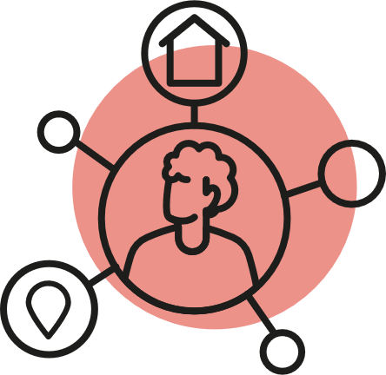
X
14
Influence & Sense of Control
Voting
When things happen in my place how well am I listened to and included in decision-making?
1
2
3
4
5
6
7
Things to Think About...
Does the community have a voice?
Is the community listened to?
Are there effective local groups?
Do I feel able to take action on my own or with neighbours?
Are there barriers for some people?
General Feedback
Type your feedback here
Type your feedback here
Type your feedback here
Type your feedback here
Type your feedback here
Type your feedback here
Type your feedback here
Type your feedback here
Notes:
Having a voice in decision-making can help to build stronger communities and better places. Having a sense of control can make people feel positive about their lives.
Things to Think About...
Does the community have a voice? (confidence to take part, getting involved, influencing decisions, doing things ourselves, do we know and successfully exercise our rights)
Is the community listened to? (are our needs understood, who do we talk to, how are we consulted, more or less consultation)
Are there effective local groups? (community council, residents’ association, business groups, charities or lobby groups, building/ user forums, social media)
Do I feel able to take action on my own or with neighbours? (litter picking, local improvements, working together to take action)
Are there barriers for some people? (clear language, online/ digital tools, hearing/ vision needs, disabled people, can everyone take part)

Slide 29
General Feedback
14
Influence & Sense of Control
Type your feedback here
Type your feedback here
Type your feedback here
Type your feedback here
Do all people in the place feel part of, and connected to, a vision and plan for a net zero future?
Do people feel they have the tools and support they need to reduce their emissions?
Type your feedback here
Type your feedback here
Type your feedback here
Type your feedback here
Type your feedback here
Type your feedback here
Type your feedback here
Type your feedback here
Is there a positive vision for the community’s future?
Does it include what the place may look like because of climate change?
Type your feedback here
Type your feedback here
Type your feedback here
Type your feedback here
Notes:
Do all people in the place feel part of, and connected to, a vision and plan for a net zero future?
Do people feel they have the tools and support they need to reduce their emissions?
Is there a positive vision for the community’s future?
Does it include what the place may look like because of climate change?

Slide 30
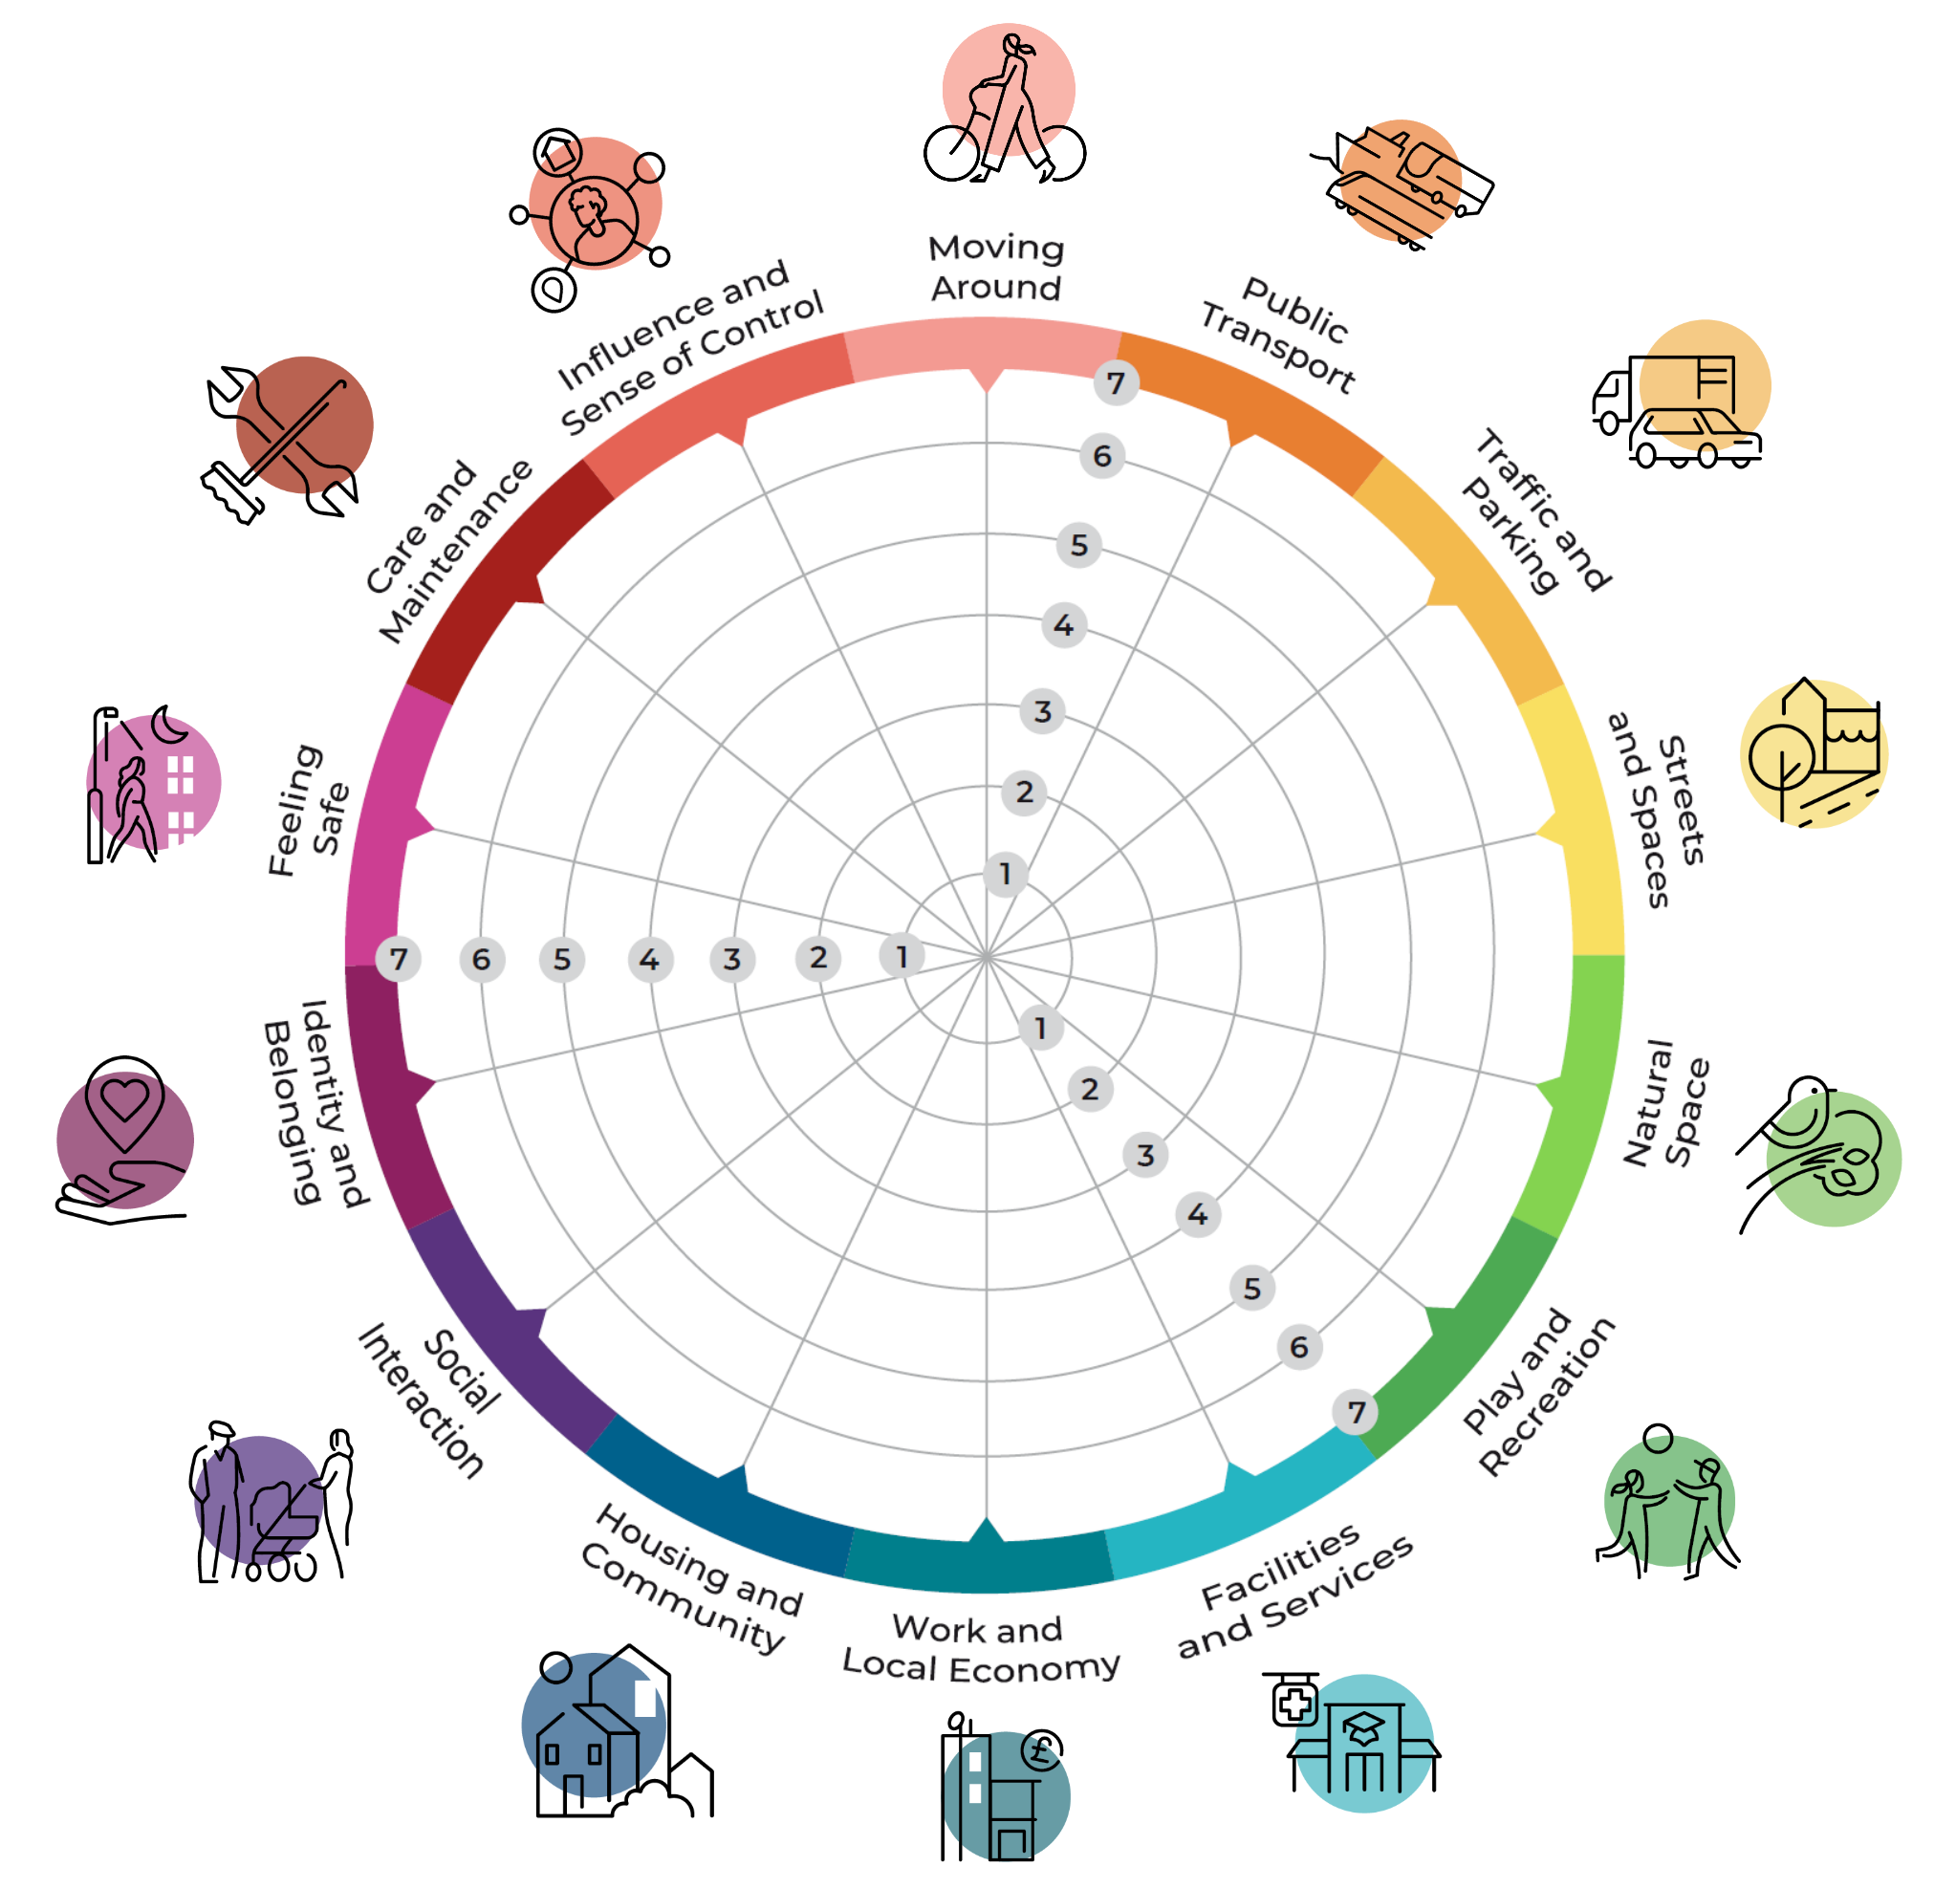
Results
Strengths
1
2
3
Area for improvement
1
2
3
Notes:
Use the grey dots to plot on the group score, noting that this is just a quick average and that individual results will be analysed following the workshop.
Use the green post its to highlight the categories with the highest score.
Use the red post its to highlight the categories with the lowest score that are areas for improvement.

Slide 31
Results – Any further feedback or thoughts?
Type your feedback here
Type your feedback here

Slide 32
Next Steps
Space to list out next/follow up steps that will happen after this workshop.

