Slide 2
Introduction & Welcome

Slide 3
Session Agenda
TO BE EDITED TO SUIT SESSION
Add in diagram or details/timings of the session

Slide 4
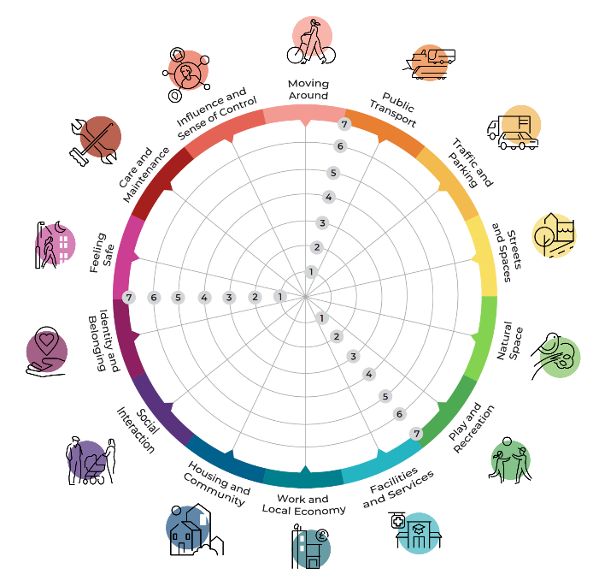
The Place Standard tool
A simple tool to structure a conversation to identify the strengths of the place and where improvements may be needed.
It has 14 themes which considers both the physical and social aspects of places, and the important relationship between them.

Slide 5
What is the Place Standard Climate Lens?
Place making can be a slow, incremental process however climate change is happening now and fast.
The Climate Lens resource of the Place Standard has been created to provide a tool for communities to co create local climate solutions.
Additional prompt questions for each of the 14 themes.

Slide 6
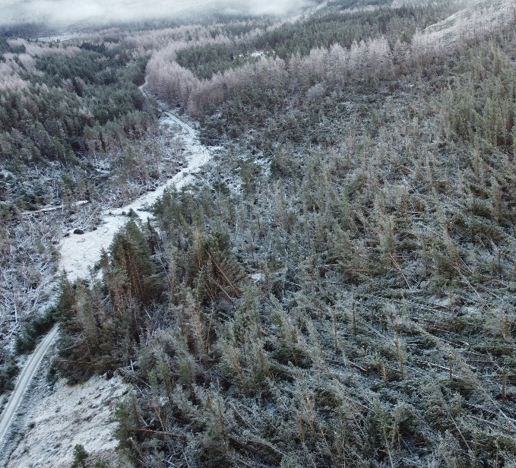
Setting the Scene
Why is climate change being considered in placemaking?
In our future climate, extreme events - such as storms, floods, droughts, and heatwaves - are likely to be more severe and to happen more often.
© Forestry and Land Scotland 2022
© Lochalsh and South West Ross Community Fire Stations 2022
How have past extreme events affected your place?
How fair is your place today?
How are energy and resources consumed or wasted?
Storm Arwen devastation
Lochalsh wildfire

Slide 7
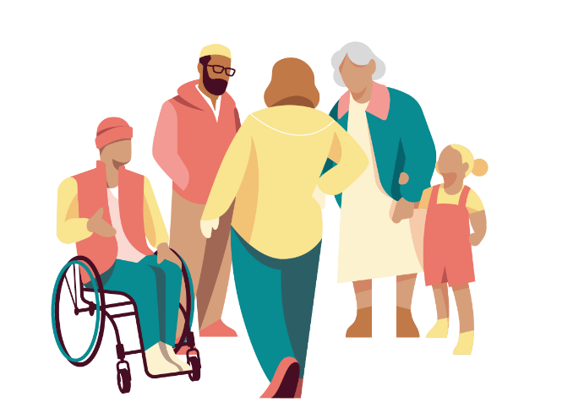
Setting the Scene
There are two interrelated aspects of how people and places need to address climate change.
Big Challenge 2
How can we adapt this place to already unavoidable climate change?
Big Challenge 1
How can we achieve our target of net zero emissions by 2045?

Slide 8
1 Action to reduce greenhouse gas emissions - mitigation
Tackling the cause of climate change by reducing greenhouse gas emissions.
Climate change mitigation action includes helping communities reduce their use of fossil fuels and use green alternatives instead; and re-greening / re-wilding places to capture greenhouse gas emissions from out of the atmosphere (also called climate change sequestration)
Big Challenge 1
How can we achieve our target of net zero emissions by 2045?

Slide 9
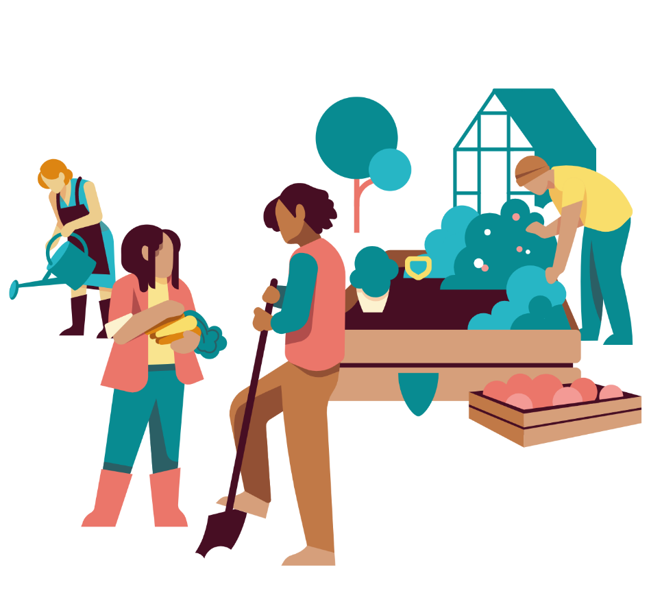
2 Action to adapt to the impacts of a changing climate - adaptation
Increasing resilience to the unavoidable impacts of climate change, so as to minimise risks and take advantages of any opportunities.
Adaptation is about increasing resilience to extremes of temperature, rainfall and increased frequency and severity of storms, and adjusting to a climate which is increasingly hard to predict.
Adaptation actions include:
> using blue green infrastructure (rain gardens, swales, sustainable drainage systems ) to slow down run-off,
> providing water fountains and cool rooms to tackle heatwaves.
Big Challenge 2
How can we adapt this place to already unavoidable climate change?

Slide 10
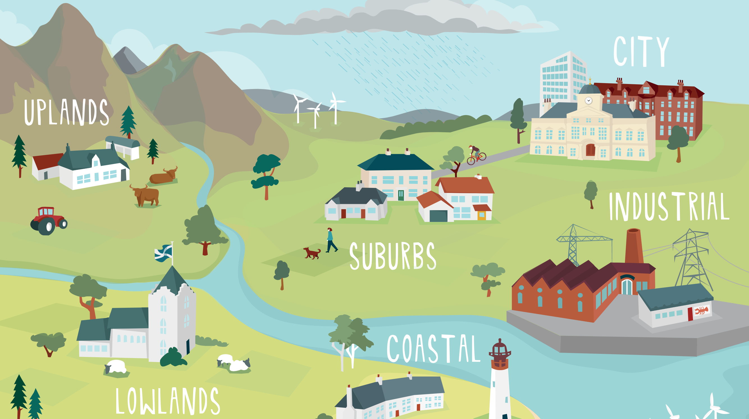
Setting the Scene
We must act to both mitigate and adapt to climate change at the same time.
Climate change is already happening now and will continue as a certain degree of warming is already ‘locked in’ from past emissions.
This means we must adapt our places to withstand these changes.
© Adaptation Scotland
Climate Ready Places, Adaptation Scotland

Slide 11
Activity Overview
TO BE EDITED TO SUIT SESSION
Overview of planned activity.
Which approach might you use – refer to pg. 7-8 of the detailed guidance for some ideas.

Slide 12
Next Steps
TO BE EDITED TO SUIT SESSION
Think about how you plan to keep participants informed of the results.
Clarify what the results are going to feed into.

